Slide 1
The Student
Leadership Challenge
Montana ACTE
October 2010

Slide 2
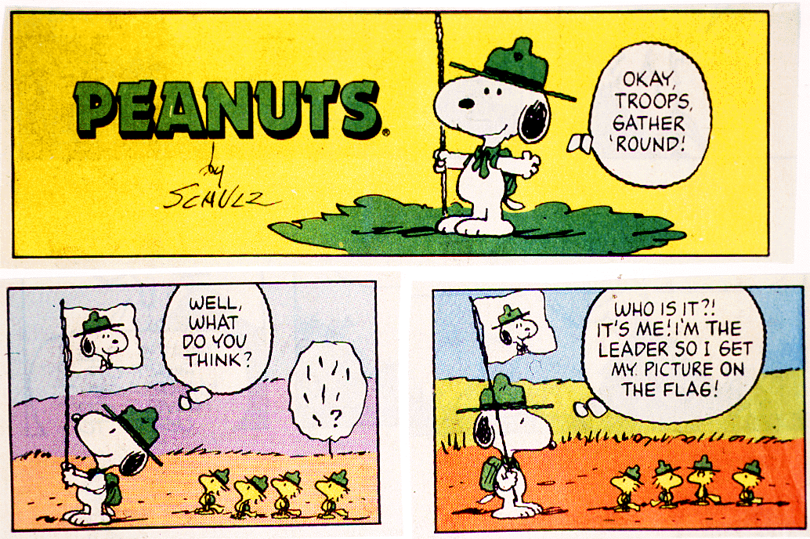

Slide 3
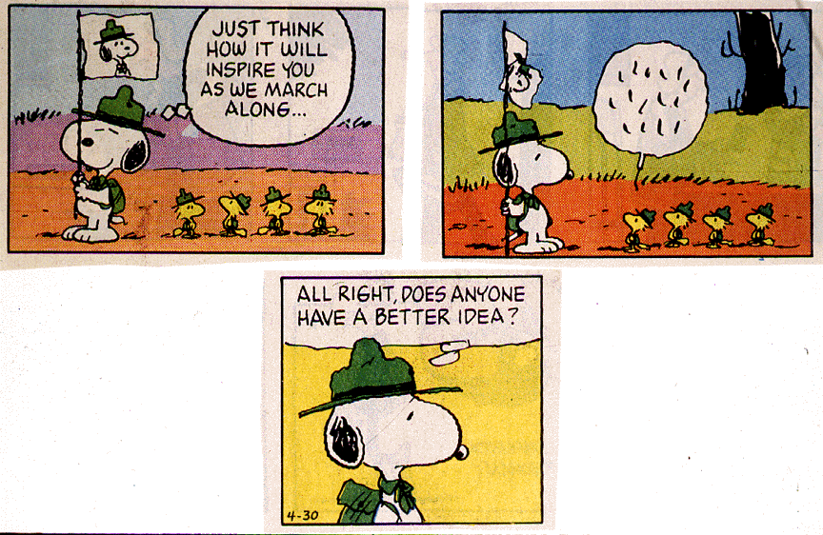

Slide 4
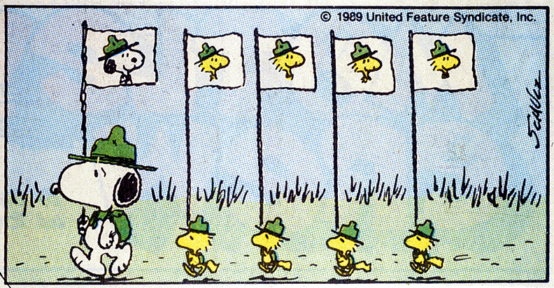

Slide 5
Peter Drucker
“Only three things happen naturally in organizations:
friction, confusion, and underperformance.
Everything else
requires leadership.”
Notes:
5

Slide 6
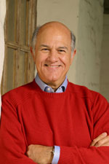
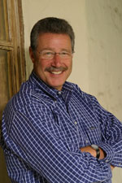
The authors
Jim Kouzes has been thinking about leadership since he was a Boy Scout growing up in the Washington D.C. area. He is also the Dean’s Executive Professor of Leadership at the Leavey School of Business, Santa Clara University. Jim is not only a highly regarded leadership scholar; The Wall Street Journal has cited Jim as one of the twelve best executive educators in the U.S.
Barry Posner is Dean at Santa Clara University's Leavey School of Business and is actively involved with curricular innovation, faculty development, and alumni relations. He serves on the boards of Junior Achievement of Silicon Valley and Monterrey Bay Public Allies (Silicon Valley), Big Brothers Big Sisters of Santa Clara County, The Center for Excellence in Nonprofits, and Sigma Phi Epsilon Fraternity.
Notes:
The story of The Leadership Challenge began in the early 1980s with Jim Kouzes and Barry Posner.
-Jim was interested in leadership, Eagle Scout in Honor Guard at Kennedy’s inauguration, was Director of the Executive Development Center at Santa Clara University.
-Barry was a teacher and scholar of leadership at SCU, where he is now the Dean of the Leavey School of Business. He spoke at FCCLA National Leadership Conference this past July.

Slide 7
Their story
Research project began in 1983
What did people do when they were at their "personal best" in leading others?
Beginning assumption: By asking ordinary people to describe extraordinary experiences, they would find patterns of success. They were right.
Notes:
-The story begins with an intensive research project Jim and Barry undertook together in 1983.
-They began with the basic question: what did people do at their personal best in leading others?
-beginning assumption: ordinary people could be leaders.

Slide 8
The research
Everyone has a leadership story to tell
Definition of Leadership:
  “Leadership is the art of
  mobilizing others to want to
  struggle for shared aspirations.”
    --Kouzes and Posner,
    The Leadership Challenge
Notes:
l—In going through the hundreds of personal best stories, they realized that these stories seldom sounded like textbook management. They were not logical cases of planning, organizing, staffing, directing, and controlling. Instead, they were tales of dynamic change and bold action. Analysis of the stories led Kouzes and Posner to define effective leadership as “the art of mobilizing others to want to struggle for shared aspirations.”

Slide 9
Definition of Leadership
      “Leadership is the art of
      mobilizing others to want to
      struggle for shared aspirations.”
  --Kouzes and Posner,
    The Leadership Challenge
Notes:
l—In going through the hundreds of personal best stories, they realized that these stories seldom sounded like textbook management. They were not logical cases of planning, organizing, staffing, directing, and controlling. Instead, they were tales of dynamic change and bold action. Analysis of the stories led Kouzes and Posner to define effective leadership as “the art of mobilizing others to want to struggle for shared aspirations.”

Slide 10
Personal Best
Think about a time you were at your personal best as a leader … What were the key actions and behaviors you took as the leader that made a difference?
What stops you from replicating your personal best over and over?

Slide 11
The Leadership Practices Inventory
Narrowed down to 30 behaviors that exemplify leadership, which are now the heart of the inventory questions
Strong leadership linked to frequency of behaviors
500,000 leaders/ 3 million observers worldwide

Slide 12
Personal Definition
I want to be known
as a leader whom ______.

Slide 13
The Five Practices of Exemplary Leadership
Model the Way
Inspire a Shared Vision
Challenge the Process
Enable Others to Act
Encourage the Heart
It’s common sense re-articulated.
Notes:
Taking these 30 behaviors, the authors then categorized them into five specific practices. (READ THEM)
MTW- setting a personal example of what is expected; ISV all about creating a mutual consensus on the end goal and the process; CTP-thinking outside the box; EOA is not just delegating but equipping constituents with tools, trust, and space to do their jobs; EtH is about showing appreciation for a job well done. You’ll find a full description of each practice and the behaviors that contribute to it in the Five Practices of Exemplary Student Leadership Article you each received.

Slide 14
Model the Way Commitments
Clarify values by finding your voice and affirming shared ideals.
Set the example by aligning actions with shared values.

Slide 15
Are leaders BORN
or
are leaders MADE?

Slide 16
Inspire a Shared Vision Commitment
Envision the future by imagining exciting and ennobling possibilities.
Enlist others in a common vision by appealing to shared aspirations.

Slide 17
Challenge the Process Commitment
Search for opportunities by seizing the initiative and by looking outward for innovative ways to improve.
Experiment and take risks by constantly generating small wins and learning from experience.

Slide 18
Enable Others to Act Commitments
Foster collaboration by promoting trust and facilitating relationships.
Strengthen others by increasing self-determination and developing competence

Slide 19
Which is the right question?
Do you need encouragement to perform your best?
When you get encouragement does it help stimulate and sustain your performance?

Slide 20
Encourage the Heart Commitments
Recognize contributions by showing appreciation for individual excellence.
Celebrate the values and victories by creating a spirit of community.

Slide 21
Leadership isn’t a place, it’s a process.
It involves a set of skills and abilities
that are useful whether one is in the
executive suite or on the front lines,
on Wall Street, Main Street or
High School Avenue, in corporations,
communities, or college campuses.
Leadership is
everyone’s business!
Notes:
Leadership is not positional, it’s behavioral. Many people who are not in formal leadership positions though, often don’t think of themselves as leaders. This process helps one identify all the leadership moments in their lives.

Slide 22
Leaders
DWYSYWD
Do What You Say You Will Do

Slide 23
Why does the model work?
Elegantly Simple
Links Theory to Practice
The Gift of Feedback
Notes:
-power of the model=so simple: concise, comprehensive, and straightforward. The message is that practicing good leadership doesn't have to be complicated.
-simple and straightforward (not=) easy to put into action. Breaks leadership into bite-size pieces, uses the SLPI to measure; leadership is easier to understand, put into practice, measure results, and make a difference
-360-degree feedback from anonymous observers gives a clearer view of what behaviors are frequent, and which ones need more attention.

Slide 24
What will students learn?
Leadership skills are essential in today’s world
Makes them more competitive for college and the workplace
Helps students think through their roles in their own lives, and identify themselves as leaders
Leadership can be applied to any situation
Notes:
-Leadership skills are a sought after ability in the job market and in life
-Prepares students for the leadership training and positions they’re likely to face in college
-Prepares students for the leadership trainings and success they’d like to achieve in the workplace
-Leadership behaviors are necessary in just about any situation: community service, family crises, personal interests and activities (give brief story of using it as a financial planning tool).

Slide 25
Who else is using this?
American Red Cross
Boeing
Hewlett Packard
Herman Miller
Fed Ex
Intel
Nestle USA
Northrop Grummond
Staples
Wells Fargo
Boston University
Cornell
Carnegie Mellon
Florida State Univ.
Georgia State Univ.
Michigan State Univ.
Stanford University
UC Santa Barbara
*Find a more extensive list at www.leadershipchallenge.com
Notes:
Preparing students for the world of work is our charge and what better way to do that than to expose them early one to one of the most used leadership models in colleges and corporate America.

Slide 26
What are the materials?
For the student:
Student LPI- 1 token = 1 online self assessment and unlimited online observer assessments
The Student Workbook*
The Student Planner*
The Student Leadership Challenge
For the instructor:
The Facilitator’s Guide*
*downloadable versions come free with purchase of online token.

Slide 27
How do you get the materials?
You can purchase books from Wiley for a discount. List price for books is $25. FCCLA store sells them for $20.
Tokens can be purchased from Wiley or at www.studentlpi.com with promo code ULEAD for $15.
Paper assessments are available. Self-assessments can be self scored and are $3.50 before discounts.

Slide 28

www.leadershipchallenge.com
More in-depth explanation
Related research, including author’s own psychometric research
Curriculum Guides
Case studies
Links to author’s podcasts and webinars
TLC Blog
TLC Newsletter
More “best leadership stories” from students
Notes:
There are tons of free resources about leadership available on this website. Bookmark it.

Slide 29
Other Resources
Downloadable lesson plans
  FCCLA website under lesson plans
Facebook Fan Page, Linked In Group
The Student Leadership Challenge book
Online assessment

Slide 30
Why SLC is needed
The language connects the generations
The material inspires up to want to be more competent in the leadership market
It is relevant to the time we live in
It is immediately applicable

Slide 31

What will be your legacy?

Slide 32
Thank you!
Megan Anderson
Office of Public Instruction
406.444.3599
manderson2@mt.gov
Cathe Felz
Three Forks High School
406.285.3224
fcclacathe@hotmail.com

